Slide 1

The Aquarium
Design of an cloud-based IoT application that controls the state of the rooms and the tanks of an aquarium
Leonardo BACCIOTTINI
Federico PACINI
Marco PETTORALI
A.A. 2019-2020

Slide 2

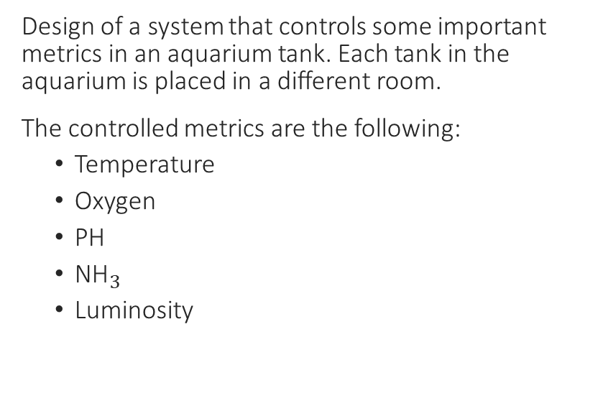
Definition of the application
Design of a system that controls some important metrics in an aquarium tank. Each tank in the aquarium is placed in a different room.
The controlled metrics are the following:
Temperature
Oxygen
PH
${\text{NH}}_{3}$
Luminosity
Questa foto di Autore sconosciuto è concesso in licenza da CC BY-SA

Slide 3
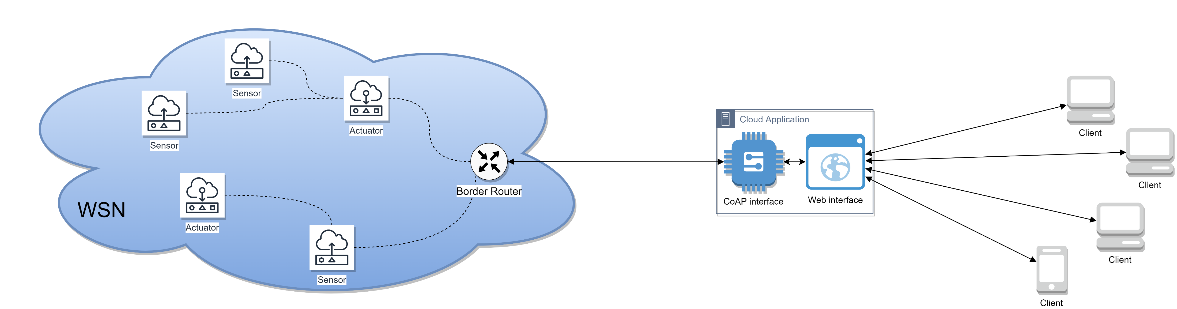
Structure of the application
The application is composed by:
A Wireless Sensor Network composed by devices running Contiki operative system (simulated as Cooja motes in Cooja simulator)
A cloud application administrating the devices registered to it
A web interface provided by the cloud application to let clients interact with the sensor network

Slide 4

Sensors and actuators
Oxygen : Sensor, Actuator (oxygenator)
Luminosity : Sensor, Actuator (bulbs)
Temperature : Sensor/actuator (thermoregulator)
PH : Sensor
${\text{NH}}_{3}$: Sensor
Water : Actuator (valve)
Each room requires the deployment of one sensor for each metric
There can be more bulbs in the same room
Thermoregulators are very common devices, and act both as sensor and actuators on temperature metric
High values of PH and NH3 require the water in the tank to be partially substituted through a water valve

Slide 5
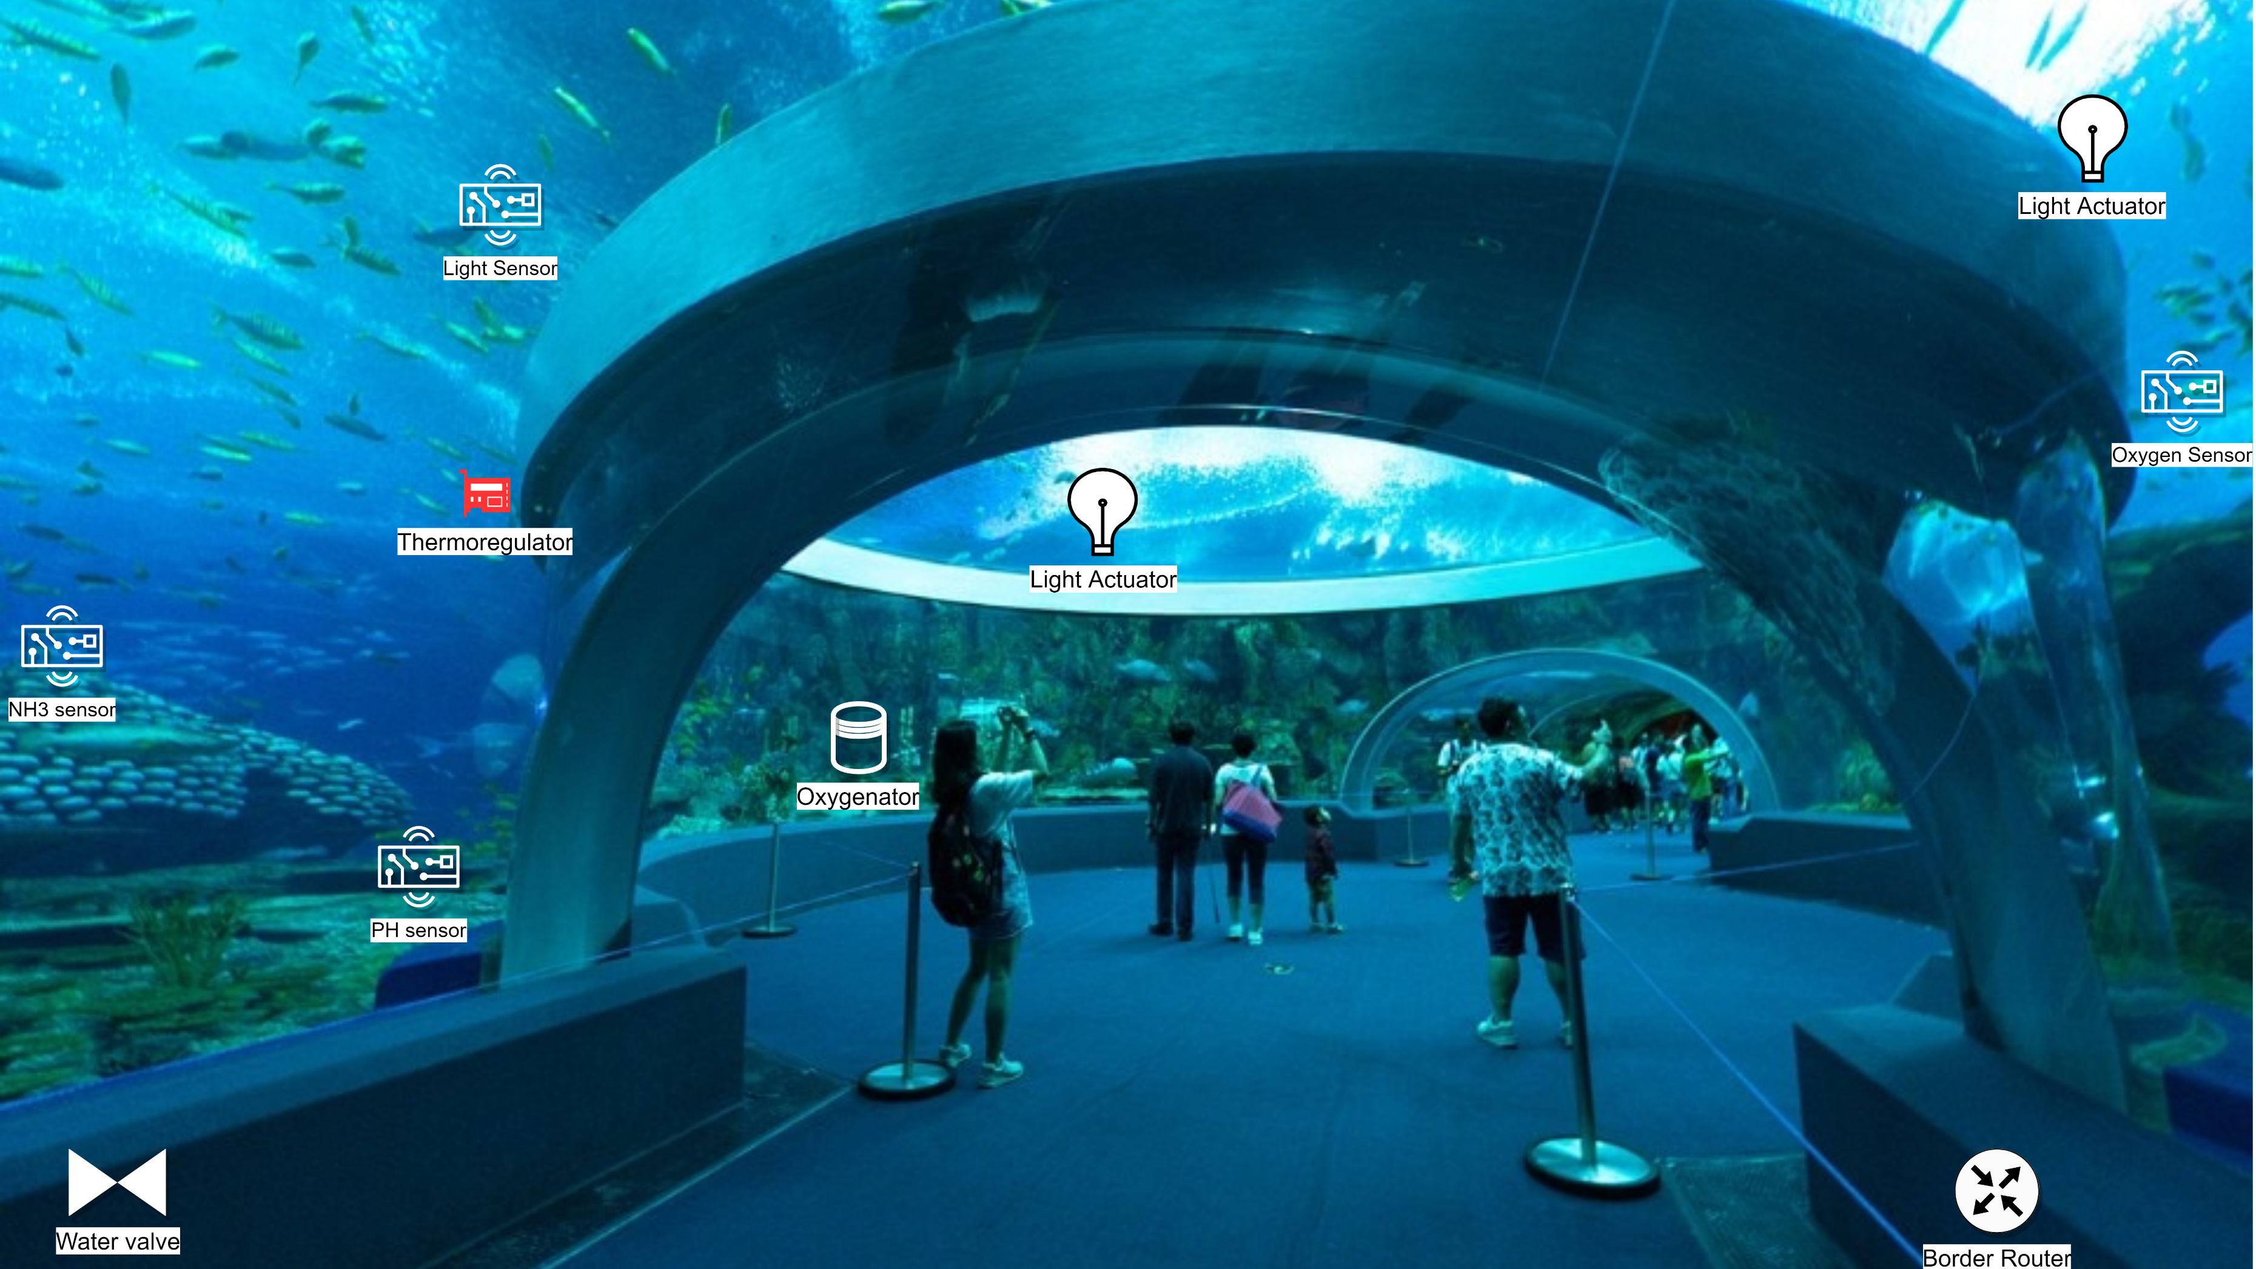
Example of deployment in a room

Slide 6
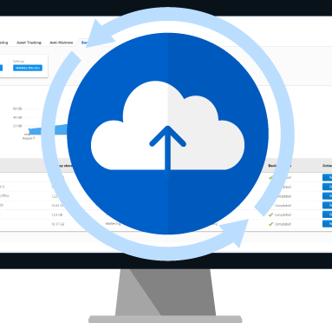
Registration to the cloud application
Devices register to cloud application by performing a POST request on the «devices» resource offered by the cloud CoAP server. The payload of the POST request is a JSON string containing informations about the id, the room, the type of device and the metric controlled by the device
After the registration, the cloud application creates an observer to trace the variations of the sensed values, in case of sensor devices, or the variations on the state of the actuators (on/off).

Slide 7
Sensors
Sensors provide a CoAP resource (called after the metric’s name)
Cloud application provide these data to the web clients
Actuators observe these values in order to know when change their status, using a Machine-To-Machine communication approach

Slide 8
Actuators
After the registration to the cloud application, actuators query the registered devices database to retrieve the address of the sensor in the room that matches its metric
Actuators then observe the sensed resource on that device
Actuators have thresholds: when the sensed value exceeds one of the thresholds, the actuator autonomously performs an action (e.g. switches on/off, increase its power…)
Thresholds can be modified by the clients

Slide 9
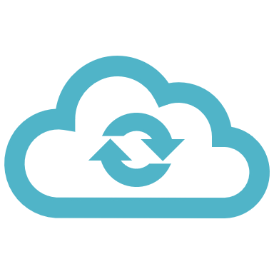
Cloud application - CoAP
The cloud application has some Observer thread that observe the values produced over time by the sensors and stores them in a structure called DataHistory, a circular array that collects at most 256 past reads, each one associated with its timestamp.
When a user wants to retrieve those data, it has to ask for the data collected by the observer after a certain timestamp
The cloud application receives commands from the clients (such as threshold edits, forcing an actuator to run or to stop) and forwards them to the wireless sensor network
The actuators are controlled using PUT methods

Slide 10
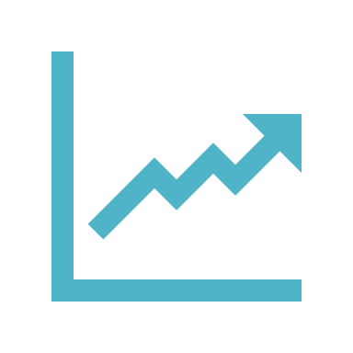
Cloud application – Web interface
The web interface provides the user the number of rooms in the aquarium, and a list of all sensors and actuators in each room
For each device, some actions are possible:
Track the variations of the resource using a graph
View the status of the sensor (working/error)
Turn on/off the actuators
Set the thresholds of each actuator
Set the period of the sensors

